Slide 1
A Generative Model of the Mutual Escalation of Anxiety Between Religious Groups
Dr. Ross Gore
Virginia Modeling, Analysis & Simulation Center (VMASC)

Slide 2
Mutual Escalation of Anxiety Between Religious Groups
Research Questions:
Do mutually escalating anxious contexts play a role in promoting religiosity?
If so, under what conditions and through which mechanisms?

Slide 3
Mutual Escalation of Anxiety Between Religious Groups (Periods of 3+ Years)

Slide 4
Research Method: Agent Based Model
What?
Computer simulation of the global consequences of local interactions of members of a population.
Why?
Formal: Assumptions and details are made explicit
Tractable: Easier to cope with complexity b/c it supports the expression of nonlinearities, discontinuities, heterogeneity.
Generative: Provides an existence proof. If you didn’t grow it, then you didn’t show it.

Slide 5
Research Method: Agent Based Model
TMT: Terror Management Theory - When death awareness is an input the outputs are increased acceptance of the existence of supernatural agents and increased resistance to engaging other cultures.
SIT: Social Identity Theory. Evaluating one’s own group positively leads social groups to attempt to differentiate themselves from each other
IFT: Identity Fusion Theory. How individual identity interacts with group identity in a synergistic and reinforcing dynamic

Slide 6
What is in the model?
Agents organized into a majority and minority group interacting in an environment of a fixed size.
Within a group the agents are connected via social networks.
Predation & Natural Hazards are generated every time step.
Social and contagion hazards can occur when agents encounter agents in the other group.
Each agent has a threshold for each type of hazard.

Slide 7
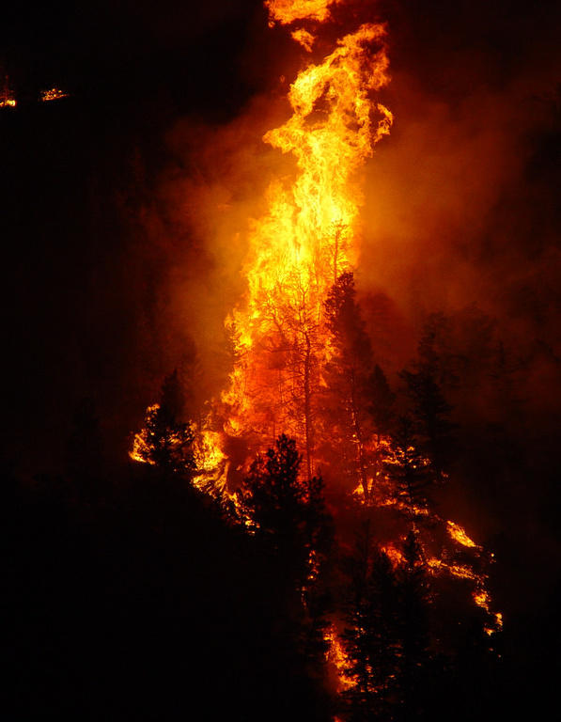
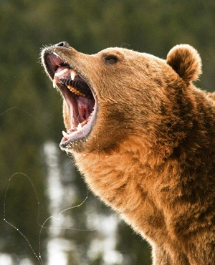
Natural & Predation Hazards
Predation & Natural Hazards are generated every time step.
Each agent has a threshold for each type of hazard.
If intensity of the hazard is above the threshold then the hazard effects the agent.
Natural Hazard Predation Hazard

Slide 8

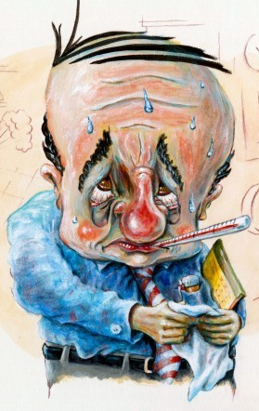
Social & contagion Hazards
Social & Contagion Hazards are generated every time step.
Each agent has a threshold for each type of hazard.
If intensity of the hazard is above threshold & agent finds another agent from the other within a specified radius then the hazard effects the agent.
Social Hazard Contagion Hazard

Slide 9
What happens in the model?

Slide 10
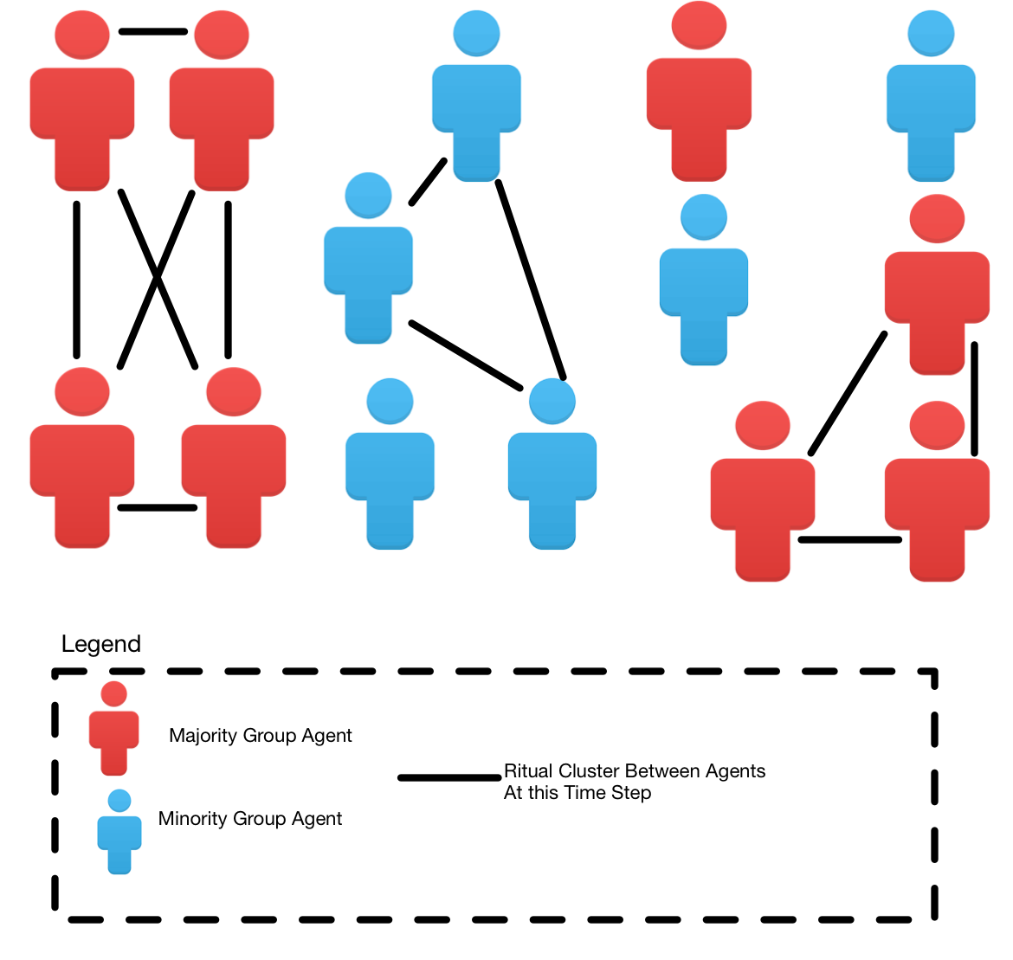
Ritual clustering
Occurs when anxiety > hyper vigilance threshold.
Agent finds other agents in same state.
Agents form a ritual cluster.
Cluster decreases anxiety and increases religiosity.
Notes:
The right side of Figure 5 highlights those actions that occur if the anxiety level of the agent exceeds the agent’s hyper-vigilance threshold. When this occurs the agent searches for other agents in the same group who have also surpassed their hyper-vigilance threshold to share in a religious ritual. The process of seeking out potential ritual partners begins with the agent searching his/her social network connections, then (if necessary) searching the social network connections of each agent to which s/he is connected. These rituals reflect meetings that occur after an individual tragedy or stressful time (Murphy et al. 2002; Gozdziak 2002).
If an agent finds a sufficient number of agentswhohave also passed their hyper-vigilance threshold then a ritual cluster is formed among the agents. While agents are scanning for, or are in, a ritual cluster they can no longer experience hazards. Furthermore, agents in a cluster are unavailable to participate in ritual clusters with other agents. If an agent is unable to find a sufficient number of agents to form a ritual cluster then s/he continue the search in the next time step.
Once a ritual cluster is formed: (1) the AP value of the agent is increased according to Equation 2, (2) the SP value of the agent is increased according to Equation 3, and (3) the anxiety of all the agents in the cluster is decreased according to Equation 1 when a hazard is not perceived. These actions occur for each agent in the cluster each time step. When the anxiety level of each agent in the cluster is below each agent’s hyper vigilance threshold then the ritual is complete and the cluster disbands. Figure 6 shows a screen shot of a population of 14 agents (8 majority group / 6 minority group) where three ritual clusters exist (2 majority group / 1 minority group) at the given time step.

Slide 11
Is Mutually Escalating Anxiety Produced?

Slide 12
How Frequently Is Mutually Escalating Anxiety Produced?
Notes:
First we investigate the extent to which the model produces mutually escalating xenophobic anxiety. There is not a requirement within the model for there to be a time series of mutually escalating anxiety. To understand how frequently this condition can occur we conducted a sweep of the model’s parameter space. The values of the following variables are altered in the parameter sweep: (a) percentage of agents in the majority group; (b) the mode of the distribution governing the agent threshold for natural, predation, social, and contagion hazards; and (c) the mode of the distribution governing the intensity value for natural, predation, social and contagion hazards. The parameter sweep produced data for a combined 5,000,000 time steps of the model across 20,000 runs (each run extends across 250 time steps). Of those 5,000,000 time steps, 1,212,673 (24.25%) lie within an interval of escalating levels of anxiety for one or both of the groups.
This percentage is significant. If our model sampled probability distributions randomly we would expect a far greater proportion of time steps (43.75%) to occur within windows of escalating anxiety, whether the duration of escalation is short or long. Butwe see 24.25% not 43.75%. This relatively lowpercentage reflects the manner in which conditions within our model must combine to produce escalating levels of anxiety.
It also shows that the most common escalating xenophobic anxiety time series is: Minority Group Escalating /
Majority Group Not. Recall that a requirement for an agent to experience a social or a contagion hazard is for
the agent to locate another agent from the other group within a specified radius. Since there are more majority
group agents than minority group agents, minority group agents have an easier time locating agents on the
landscape fromthe majority group. This results in agents within the minority group experiencing more encounters
with potential social and contagion hazards thereby making aect increases more likely. The frequency of
mutual escalation and the Majority Group Escalating / Minority Group Not Escalating is similar, meaning that
about half the time the majority group experiences escalating anxiety, so does the minority group.

Slide 13
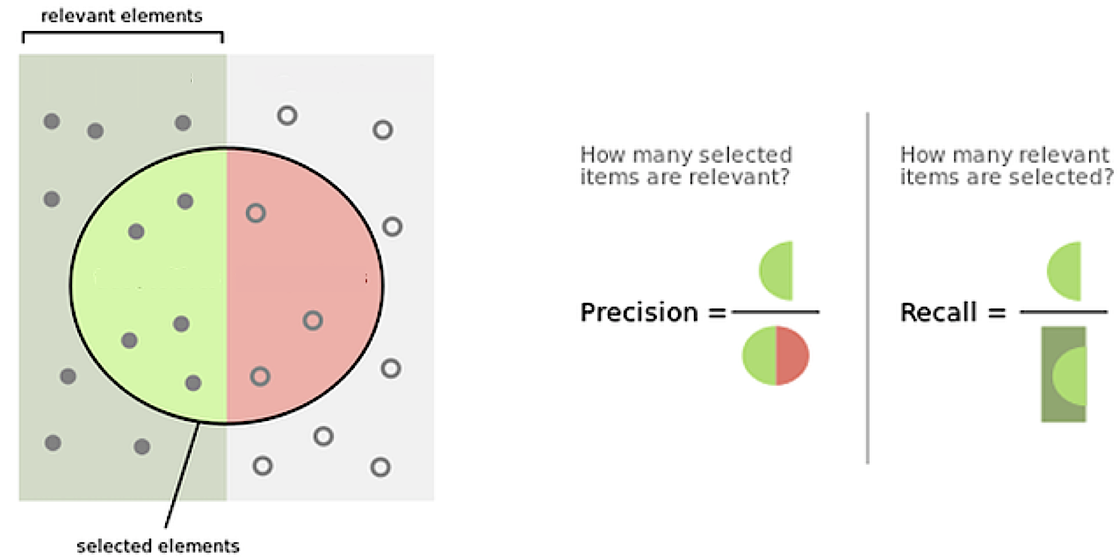
How Do We Explain Why It occurs?
We want to look conditions related to input parameters that yield a relevant output (i.e. mutually escalating anxiety)
Adapt two information retrieval measures

Slide 14
How Do We Explain Why It occurs?
We want to look for conditions (i.e. propositions about input parameters) that are true when:
A mutual escalation period of any length occurs. (Precision)
ALL mutual escalation periods of any length occur. (Recall)
We want conditions where these measures increase and approach 1.0 as the length of the mutual escalation period increases.
Precision and Recall can be aggregated into a single measure.

Slide 15
How Does Mutual Escalation occur?

Slide 16
Back to research questions
Do mutually escalating anxious contexts play a role in promoting religiosity?
Yes, it causes some agents in each group to exceed their hyper-vigilance threshold, participate in a ritual cluster and become more religious. In longer periods of mutually escalating anxiety more agents in each group increase their religiosity.
If so, under what conditions and through which mechanisms?
More equal group sizes (less than 70/30 split), where agents’ social and contagion hazard threshold is below the average social and contagion intensity are most predictive conditions of prolonged periods of mutually escalating anxiety.

Slide 17
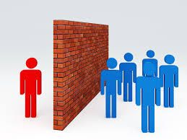
Large scale implications
Maintain a large disparity in group sizes.
Reduce likelihood of social and contagion hazards being perceived.
Physical barriers between groups.
Increase spatial dimensions of interaction between groups. Larger landscape, fewer others within radius.

Slide 18

Acknowledgement & thank you

